Slide 1

CVM ANALYTICS CASE · CELLMOV CROSS-SELL
AI-Driven Offer Personalization:
From One-Size-Fits-All to 4.7× Campaign Margin
Building an offer-recommendation model to optimize a CVM campaign with Machine Learning
Daniel Silva Barrera · July 2026

Slide 2

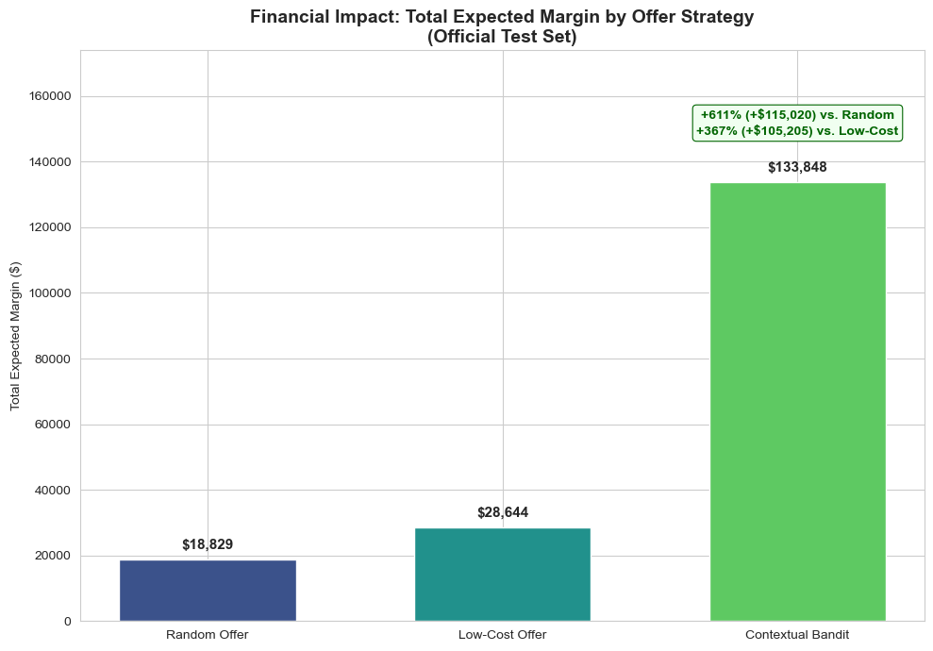


EXECUTIVE SUMMARY
An AI offer recommender multiplies campaign margin 4.7× vs. today’s fixed low-cost strategy, adding $105K per 50K-lead wave
CellMov leads mobile but is a distant #2 in fixed broadband. Cross-sell via outbound calls is the growth lever, and the first offer pitched decides the call.
Total expected margin: Official 50K validation base
Situation
Offer assignment is non-analytical. Random offers convert 0.9%, the ops one-size-fits-all low-cost offer converts 2.3% but caps value at $25.06 margin per convert, it sells the cheapest bundle to everyone.
Complication
A contextual-bandit recommender assigns each customer the valid bundle maximizing expected margin: P(convert) × bundle margin, reaching 5.7% conversion and $133,848 margin on the official 50K test base.
Resolution
Dataset: final_test_validation_base
0.9% → 2.3% → 5.7%
$2.68 vs $0.57
4.67× (+$105,205)
7.11× (+$115,020)
CONVERSION: RANDOM → LOW-COST → BANDIT
MARGIN PER LEAD VS. LOW-COST
MARGIN LIFT VS. LOW-COST STRATEGY
MARGIN LIFT VS. RANDOM BASELINE

Slide 3
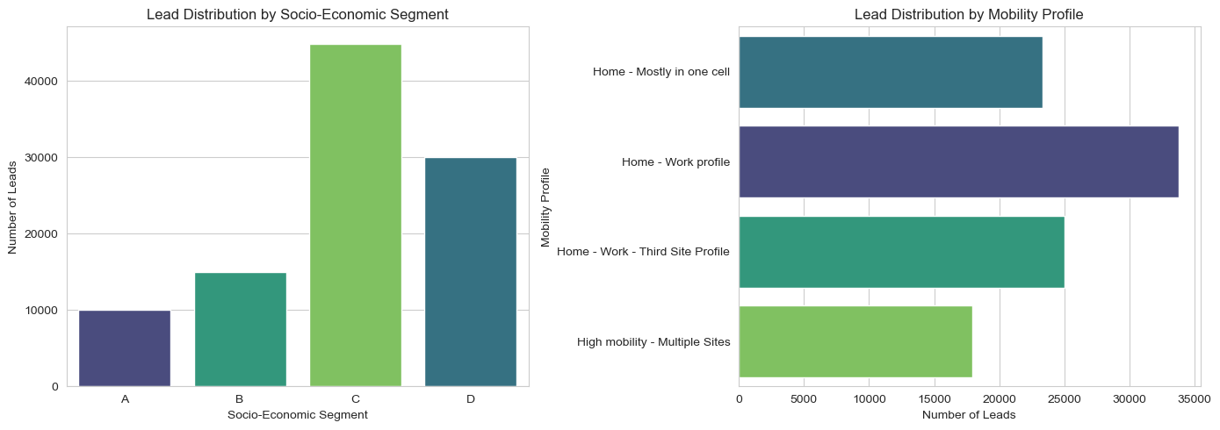


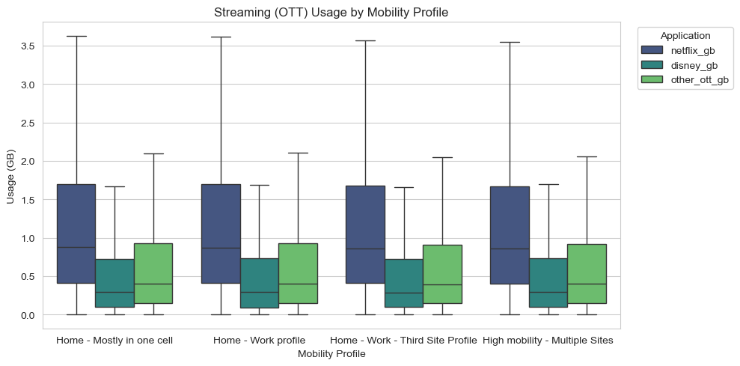

LEAD BASE PROFILING
The 100K lead base is not one market: Segment, mobility and streaming behavior define micro-segments with different willingness to pay
Who the leads are?
Affluence is scarce, not volume
Segment A is a minority of leads yet, as the model later confirms (+2.83 log-odds), carries the highest conversion propensity. Lead quality, not quantity, is the binding constraint.
Home time = Fixed-product need
Home-centric profiles concentrate streaming (Netflix, Disney, YouTube) consumption, natural targets for high-speed internet, Premium TV and OTT bundles. High-mobility users under-index on fixed-product need.
What they consume?
Three personas emerge
Affluent Home Streamer (A/B, home-centric, heavy OTT: Premium bundles)
Value Commuter (C/D, home-work: Lean offers)
Mobile-First Nomad (high mobility: Hardest fixed-product fit).
Source: Exploratory Sections 1–2 (univariate + multivariate analysis).

Slide 4
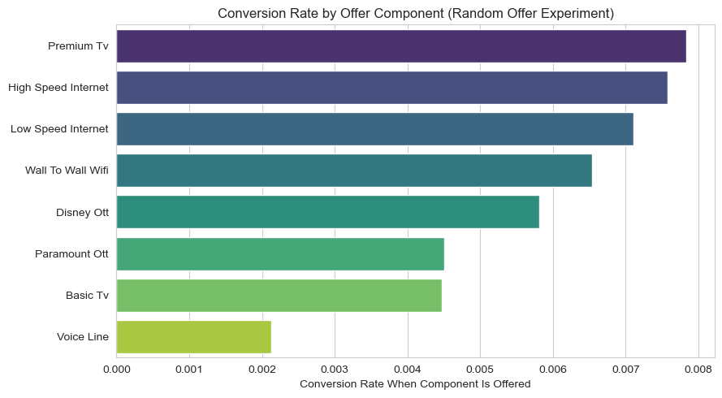

EXPERIMENT ASSESSMENT
Two field experiments reveal the conversion levers: Customers reward simple, relevant bundles and punish irrelevant add-ons like Voice
Experiment outcomes (100K leads, 50K per arm)
Acceptance rate when component is offered (random arm)
A cheap, simple, universally understandable offer more than triples random conversion (0.73% → 2.50%, margin $13.4K → $31.4K). But it is a ceiling, not a strategy: It leaves premium demand unserved.
Premium components out-convert cheap ones even at higher prices, relevance beats price (Premium TV 0.78% ≈ High Speed 0.76% > Basic TV 0.45%). Voice is a conversion killer (0.21%; logit −1.31 log-odds, p<0.001): bundling it "for value" actively destroys calls.
Offer–customer match inference: Two demand families coexist in one base. Winning random bundles split into lean & cheap (Low Speed alone: 6.3% conv.) and rich & premium (High Speed + Premium TV + Disney + WiFi: 3.9% conv., top margin per customer at $1.99). One fixed offer cannot serve both, personalization can.

Slide 5
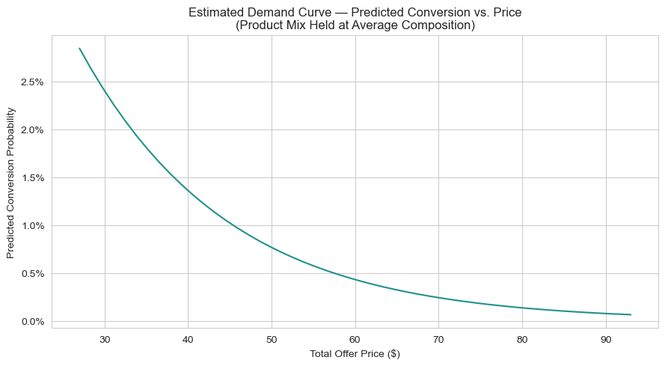
PRICE ELASTICITY
Demand is elastic: Each extra dollar cuts conversion odds by 5.6%, but elasticity differs by profile. Price cuts only pay off in value segments
Estimated demand curve: Logit prediction, product mix held at average
Magnitude: Demand slopes down
1
Each extra dollar charged multiplies conversion odds by 0.9437 (−5.6% per $), holding product mix fixed. Statistically significant and consistent with standard demand theory.
Field confirmation: With an honest caveat
2
Random mix ($59.52 avg) → low-cost offer ($37.00): +1.77 pp conversion for a $22.52 price cut (3.41× baseline). Caveat: the low-cost offer also strips add-ons, so part of the lift is mix simplification, not pure price.
Heterogeneity: Why one price does not fit all
3
Holding price constant, High Speed adds +0.82 log-odds (p=0.023) and Premium TV +1.13 (p=0.07): Premium features carry positive utility that offsets price for the right customers. Elasticity is profile-dependent, the case for personalized bundles over blanket discounts.
Model: Logit(converted) ~ total_price + product-mix flags, fitted on the 50K random-offer arm. Price coefficient −0.0580 log-odds per $1 (odds ratio 0.9437, p = 0.028). The randomized arm gives price variation the fixed offer cannot.

Slide 6
MODEL ARCHITECTURE & PARAMETER JUSTIFICATION
A contextual bandit: epsilon-greedy exploration over 96 valid bundles, scored by an interpretable logistic model, learns the policy in 10 waves
1. Context
2. Action space
3. Policy
4. Reward model
5. Learning loop
3 categorical features one-hot + 9 numeric usage features standardized
96 valid bundles by construction: internet 2 × TV 3 × add-ons 16; invalid offers impossible
ε-greedy: Explore random valid bundle w.p. ε, else exploit model’s best action
Logistic regression P(convert | customer, offer), pick argmax P × bundle margin
10 biweekly waves × 50K leads, retrain on ALL accumulated (context, action, reward)
Design choice: Why (every parameter has a business reason)?
Proof the loop learns: Conversion by training wave
ε: linspace 1.0 → 0.05 over 10 waves | Full exploration at cold start (no model exists), near-full exploitation once confident. Mirrors the biweekly campaign calendar.
Logistic regression (not GBM / NN) | Interpretable coefficients for marketing, scores 50K × 96 = 4.8M pairs fast, rubric rewards a simple, fully-owned model.
class_weight = "balanced" | Conversions are rare (<3% early): Prevents collapsing to "never converts".
max_iter = 1000 · random_state = 42 | Guaranteed solver convergence, fully reproducible learning curve.
Cumulative retraining (no sliding window) | Leads are i.i.d. draws from a stationary base, more data strictly reduces variance.
Objective: argmax P(convert) × margin | Optimizes what the CMO cares about: Expected margin, not raw conversion.
Wave 1: 0.95% · $18K margin → Wave 10: 5.40% · $128.9K margin (ε = 0.05). Wave-8 dip = sampling variance at ε = 0.26.

Slide 7
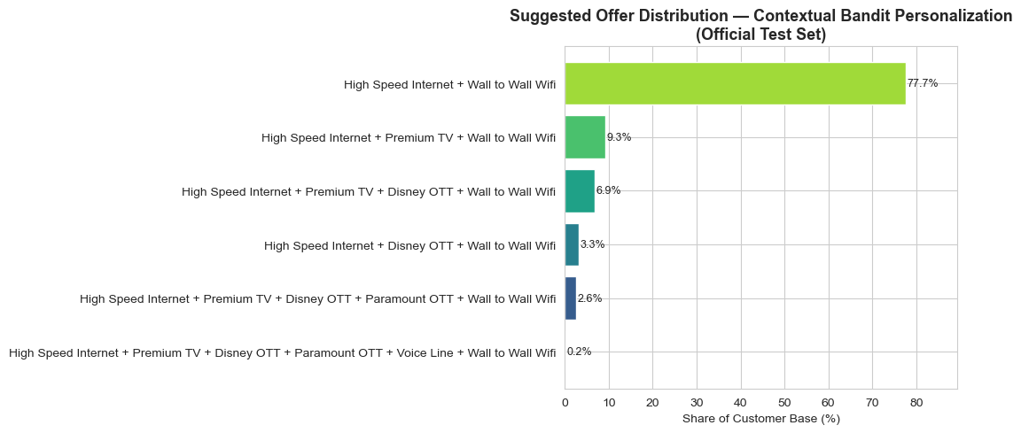
RESULTS: THREE STRATEGIES COMPARED
On the official 50K validation base the bandit delivers $133.8K margin, 4.67× low-cost, by steering every lead to a tailored high-speed bundle
Official test set: 50,000 leads, identical base for all three strategies
Personalization proof: Offer mix chosen by the policy
Strategy | Converted | Conv. rate | Total margin | Margin / convert | Margin / lead
Random offer | 470 | 0.9% | $18,829 | $40.06 | $0.38
Low-cost offer | 1,143 | 2.3% | $28,644 | $25.06 | $0.57
Contextual bandit | 2,863 | 5.7% | $133,848 | $46.75 | $2.68
The policy actively uses 6 of 96 valid bundles
High Speed + WiFi 77.7%
+ Premium TV 9.3%
+ Premium TV + Disney 6.9%
+ Disney 3.3%
+ both OTTs 2.6%
full stack 0.2%.
It never recommends Low Speed, Basic TV or standalone Voice, the exact opposite of today’s ops strategy and always attaches the $4 WiFi add-on, which raises perceived value more than it hurts price.
Concentration ≠ shortcut: Argmax of expected margin legitimately concentrates when one bundle dominates most of the customer space. The differential is who gets Premium TV / Disney added.
Lift: vs. low-cost +$105,205 (4.67×, +367%) - vs. random +$115,020 (7.11×, +611%)
Why it wins: Top model drivers (log-odds coefficients)
+2.83
+2.14
−2.61
Segment A
Home-centric mobility
Voice line attached
−2.17
−1.57
Home-Work-3rd-site mobility
iPhone mid-end device
The model independently rediscovered and quantified the business intuition of the profiling and experiment analysis.

Slide 8





AGENTIC AI USE-CASE PROPOSAL
Scaling the recommender into an agentic CVM loop can compound the $105K/wave lift while cutting campaign cycle time from weeks to days
High-level architecture: Four purposeful agents around an MLOps core
Processes transformed
DATA LAYER
1. Lead scoring & offer assignment: Monthly manual promo rules → real-time learned policy
Usage / CDR feature store - CRM - Billing margins
2. Experiment design: Ad-hoc tests → automated ε / holdout management
MLOPS CORE
Feature pipeline - Model registry - Champion/Challenger serving API
3. First-pitch call script: Generic script → personalized opening (the case showed the first offer decides the call)
AGENT LAYER
GUARDRAILS
96-action validity rules
Pricing floors
Contact policy
Human approval for new offers
4. Monitoring & retraining: Manual reviews → continuous drift-triggered loop
Offer Decision
Experimentation
Runs bandit policy per lead in real time, escalates low-confidence cases to exploration
Owns ε budget & holdout design, every wave yields unbiased learning data
Insight & Narrative
Monitoring / Drift
MEASURING INCREMENTAL VALUE
Turns coefficient shifts into weekly CMO-Readable briefs
Watches calibration, triggers retraining or rollback
Permanent randomized holdout (~5% of leads on the current low-cost rule) → incremental margin per wave = margin(agentic) − margin(holdout, scaled). Secondary KPIs: Cycle time design→launch, % offers auto-approved within guardrails, model calibration error. Baseline anchored on the measured +$105K / 50K-wave lift.
ACTIVATION
Contact-center CTI / predictive dialer · campaign manager

Slide 9


HOW AI WAS USED TO DEVELOP THIS CASE
AI acted as a pair-programmer and thought partner under human direction: Every line of code, parameter and insight was reviewed and owned
PHASE
HOW AI WAS USED
HUMAN OWNERSHIP & VALIDATION
1. Exploration
Drafted matplotlib, seaborn boilerplate for distribution and multivariate charts to help identify descriptive insights from the base.
Defined which business question each chart must answer, discarded non-insightful graphs.
2. Modeling
Proposed candidate architectures (multiclass model, per-offer models, contextual bandit) and drafted implementation code.
Selected the bandit for its fit with the sequential 10-wave design and the “fully understood > complex” rubric, challenged every parameter (ε schedule, class weighting, action-space constraints).
3. Interpretation & storytelling
Stress-tested interpretations (log-odds vs. percentage points, mix-vs-price confound) and helped draft and structure this deck under the Pyramid Principle.
Wrote the final insights, verified every number against executed notebook outputs, define the storytelling and built the final deck.
Tools Used | Development Stack: VS Code + Opus 4.8 to draft code (Cell autocomplete blocked inside CLAUDE.md, all code-generation prompts logged). Prompt Improvement: Gem in Gemini. Result Analysis: Fable(assisted analysis, not automated).

